Slide 1
Digital Signal Processing
Dr. Michael Nasief
Lec 2

Slide 2
Assignment (1)
Compare Between:
Microcontroller.
Microprocessor.
DSP.
FPGA.

Slide 3
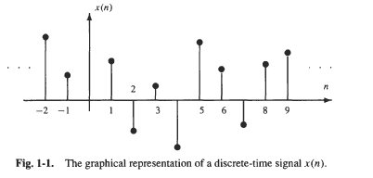
DISCRETE-TIME SIGNALS
A discrete-time signal is an indexed sequence of real or complex numbers. Thus, a discrete-time signal is a function of an integer-valued variable, n, that is denoted by x(n).

Slide 4
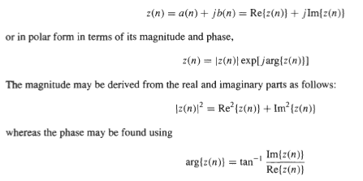
Complex Sequences

Slide 5
Some Fundamental Sequences

Slide 6
Signal Duration
Finite N1 to N2
Infinite

Slide 7
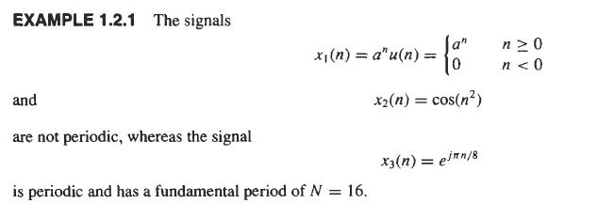
Periodic and Aperiodic Sequences
Prove

Slide 8
For Product or Sum

Slide 9
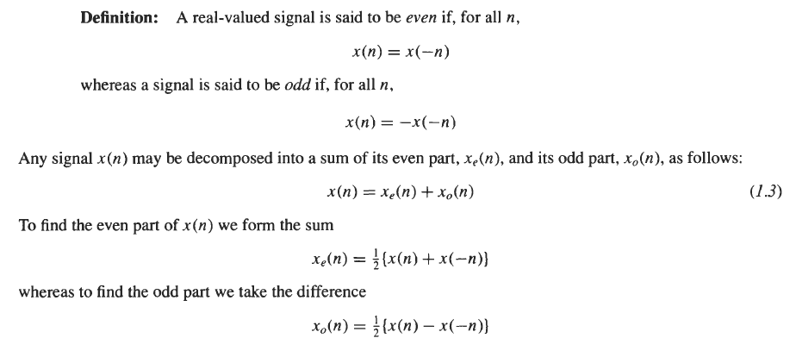
Symmetric Sequences

Slide 10
Signal Manipulations
Shifting
Reversing
Scaling

Slide 11
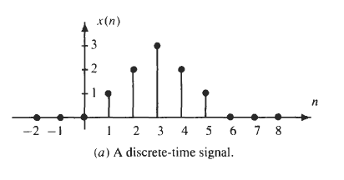
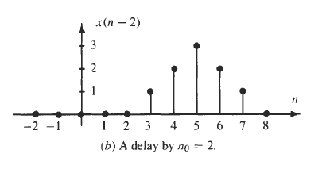
Example

Slide 12
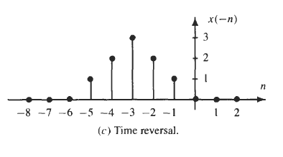
Example

Slide 13
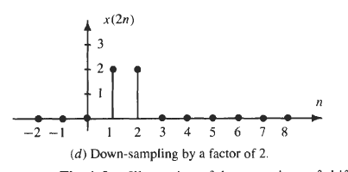
Example

Slide 14
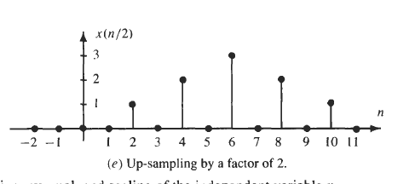
Example

Slide 15
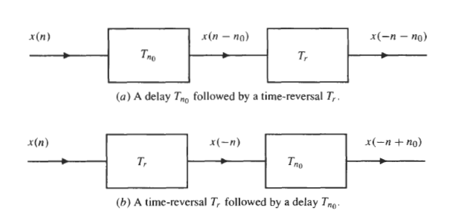
Order
Shifting, reversal, and time-scaling operations are order-dependent.

Slide 16
DISCRETE-TIME SYSTEMS

Slide 17
System Properties
Memoryless System
Definition: A system is said to be memory less if the output at any time n = no depends only on the input at time n = no.

Slide 18
Additivity
Definition: A system is said to be additive if

Slide 19
Homogeneity
Definition: A system is said to be homogeneous if

Slide 20
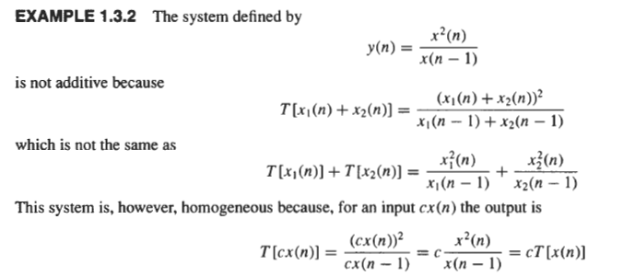

Slide 21
Problems

Slide 22
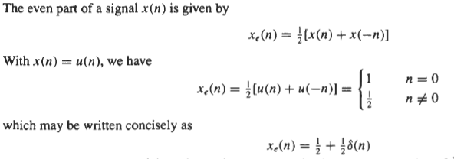

Slide 23
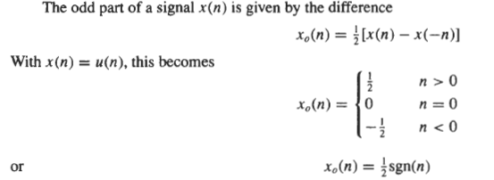

Slide 26
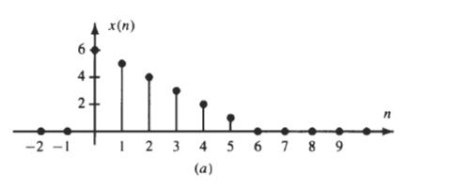

Slide 27
(b)

Slide 28
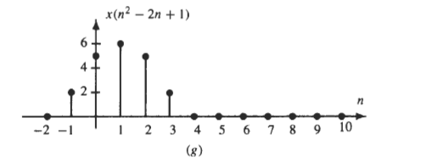
(d)

Slide 29
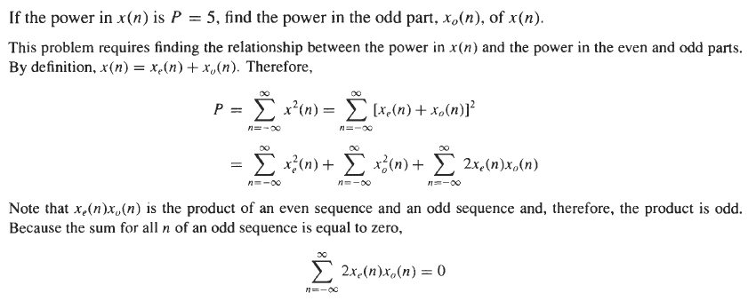

Slide 31
